Slide 1
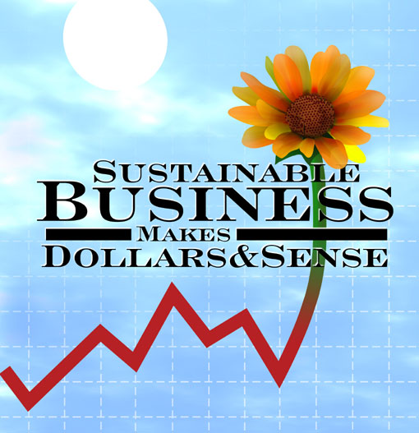
SUSTAINABLE ENTERPRISE
OVERVIEW
This presentation has been created to give a simple but holistic view of sustainability
Ian Robert Kirkwood PhD
Sep 2009

Slide 2
Program Overview
1. Global degradation, pollution, and climate change are serious issues
2. Natural resources are being consumed to the point of depletion
3. The world is rapidly becoming unsustainable for life as we know it.
4. Businesses are a major key to a successful solution
5. Our main focus - to find practical solutions – Economic, Social, Environmental – for all these issues

Slide 3
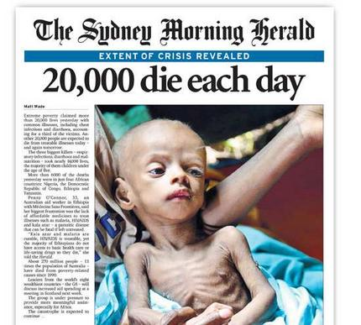
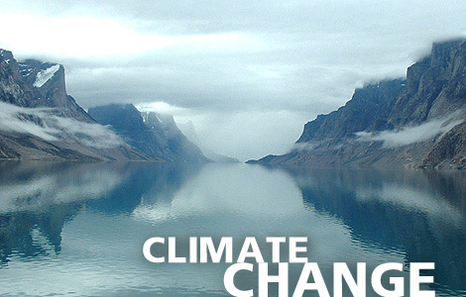
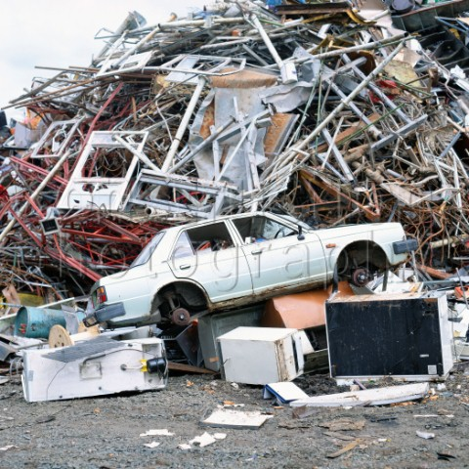
THE PROBLEM
A Bleak Future

Slide 4
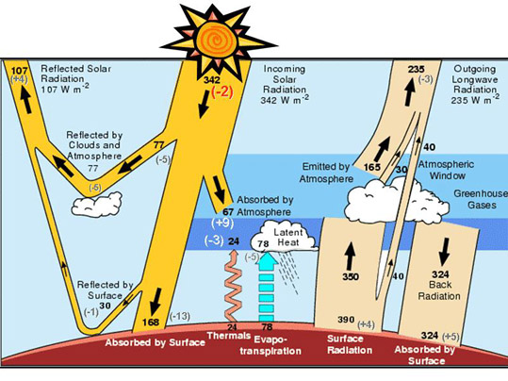
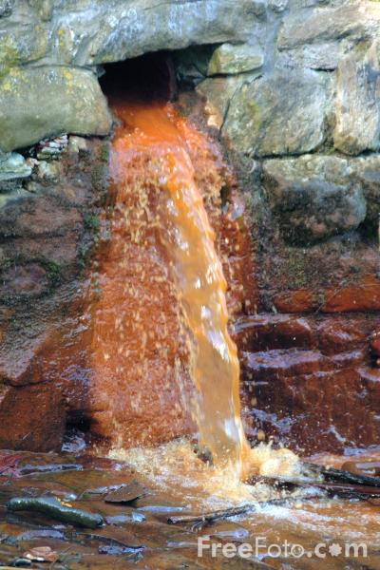
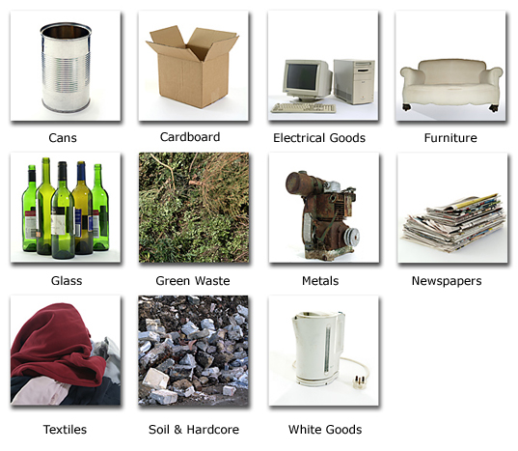
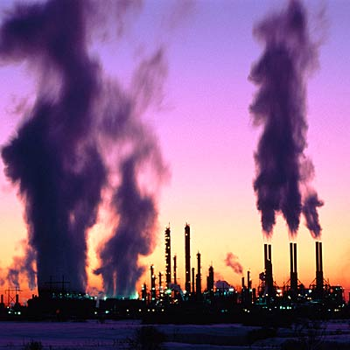
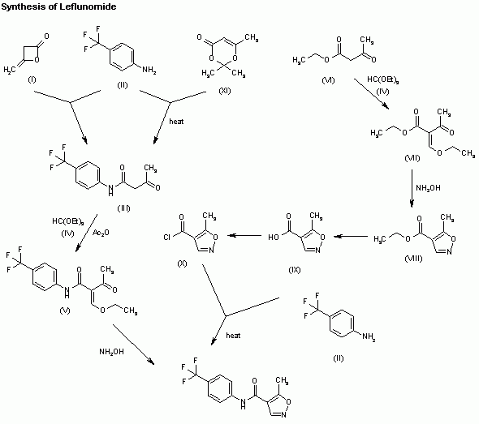
CAUSES
Waste
Pollution
Excess
COx, SOx, NOx

Slide 5

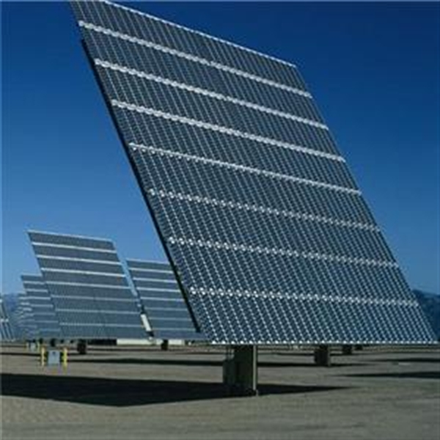
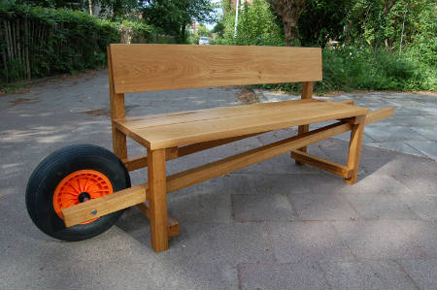
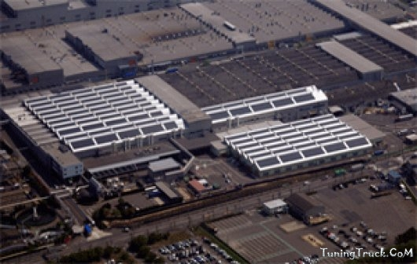
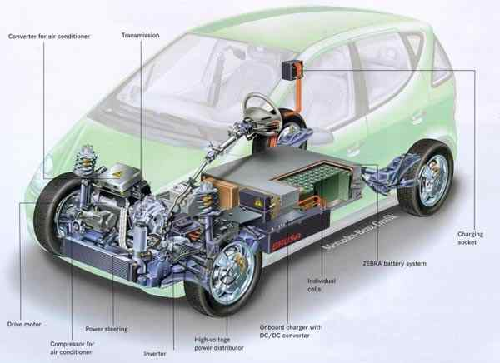
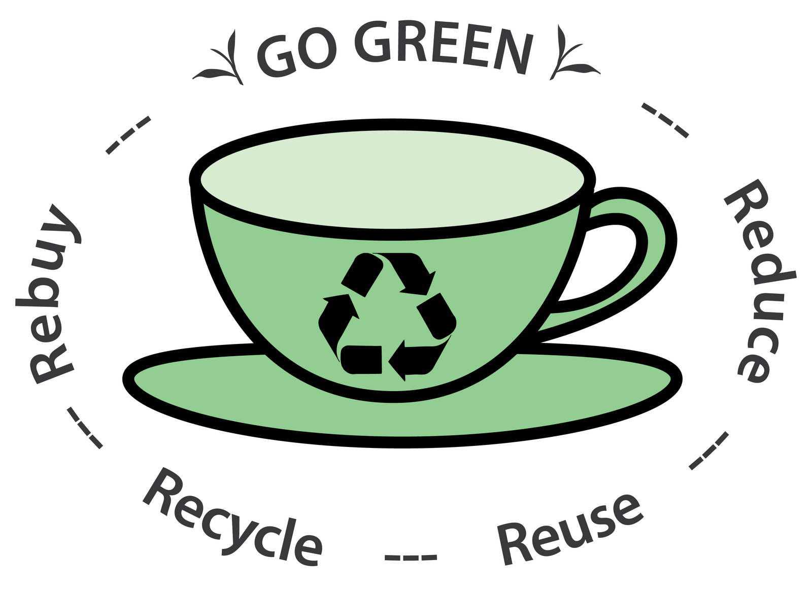
WHAT CAN WE DO
Meaningful solutions

Slide 6
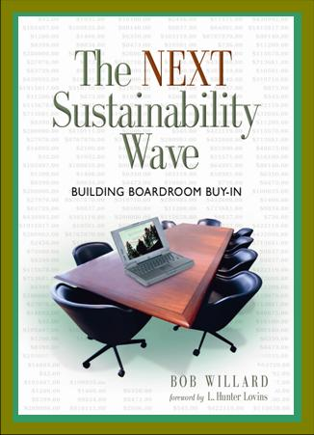
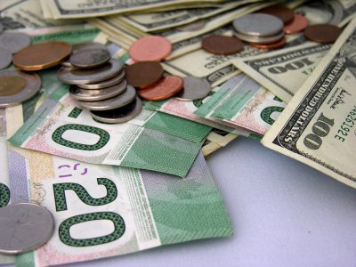
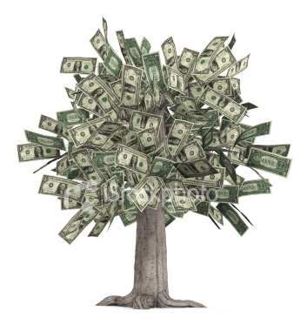
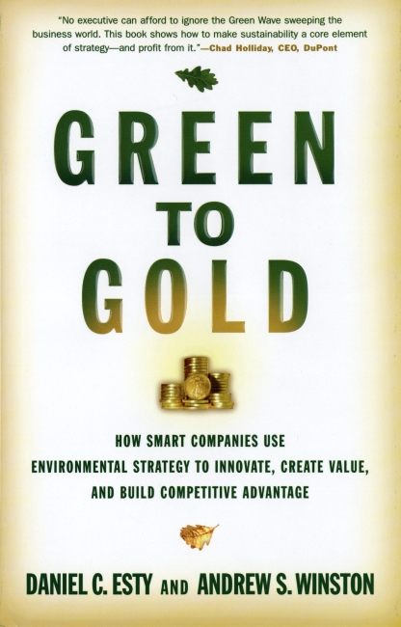
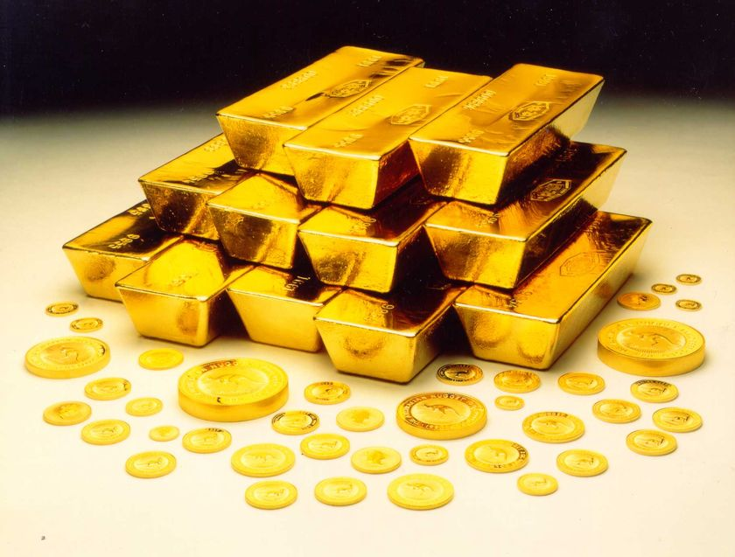
WHAT IS THE PAYOFF
Profitable Sustainable Business

Slide 7
OUR FOCUS
…. is about Business …
1. To consider sustainability within a business context
2. To determine what sustainability means for enterprises
3. To understand differences between sustainable and unsustainable products, processes and strategies
4. To develop a full business monitoring system
5. To understand sustainability from three perspectives: Profit, People, Planet
… for all types of businesses, NGOs and Governments …

Slide 8
The Measurement and Management of Sustainable Practices
1. Understanding TBL indicators
2. Understanding generic monitoring systems
3. Analysing business performance from sustainable perspectives
4. Being able to apply Dimensions and Indicators to monitoring systems
5. Being able to develop strategies for sustainable business

Slide 9
SUSTAINABLE ENTERPRISE
SESSION 1 of 7
TRIPLE BOTTOM LINE
PPP or TBL

Slide 10
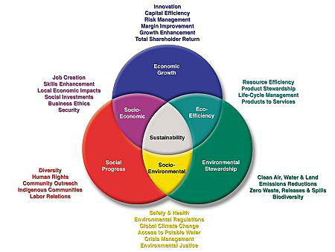
A Venn Diagram showing: Economic growth, Social progress, Environmental stewardship
Macro View
Overlap all three areas

Slide 11

SUSTAINABLE ENTERPRISE
SESSION 2 of 7
3 KEY ISSUES Biophysical,
Economic,
Socio-Cultural

Slide 12
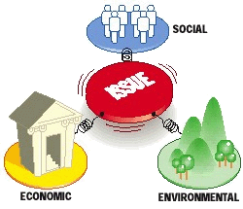

1st Key Issue
Biophysical
Economic
Socio-cultural

Slide 13
2nd Key Issue
Biophysical
Economic
Socio-Cultural

Slide 14
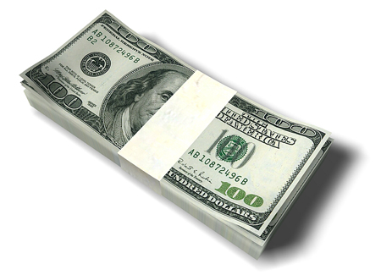
Micro View
MARKETING
1. C-Level
SP-F-B
2. Strategic
CCC-STP-R/D
3. Operational
PPPP-I-C/F
FINANCE
1. Profits
2. Sales
3. Assets
4. Equity
EVA
MVA
VCM
Raw Materials
Production
Packaging
Supply Chain
Product Use
End of life
CSR
1. SHRM
2. Stakeholders
3. Local-Global
Communities
SUSTAINABLE
ENTERPRISE

Slide 15
3rd Key Issue
Biophysical
Economic
Socio-Cultural

Slide 16
SUSTAINABLE ENTERPRISE
SESSION 3 of 7
REDESIGNING THE SYSTEM

Slide 17
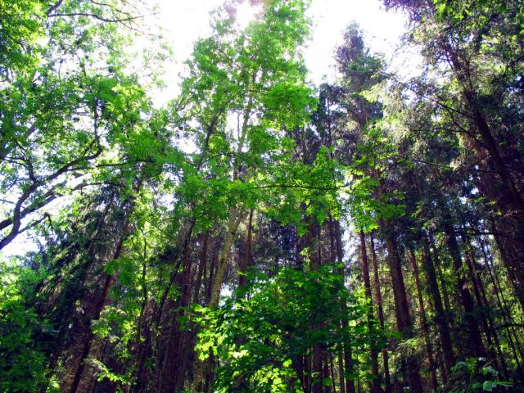
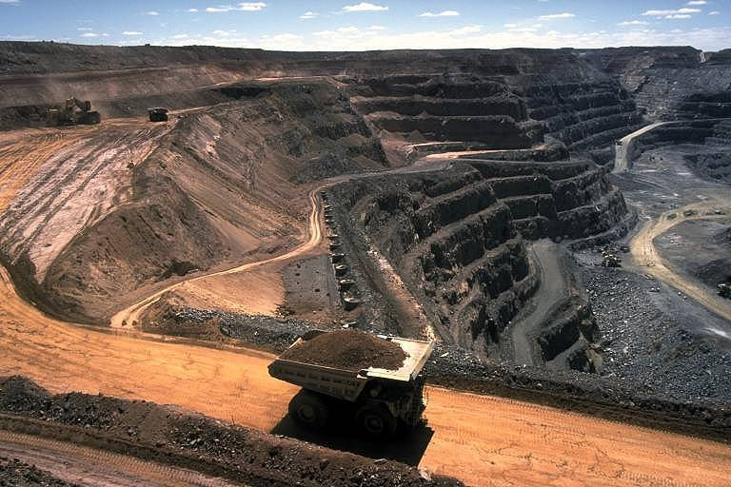
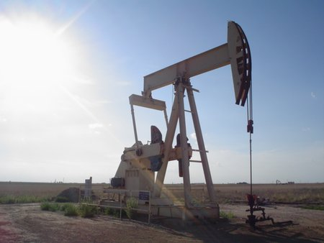
UNSUSTAINABLE MODEL
Pulp
Mill
Users
Rubbish Dump
Printer
Manufacturer
TIP
Steel
Mill
Profiler
Downstream Logistics
Extruder
Refinery

Slide 18
SUSTAINABLE ‘CLOSED LOOP’ SYSTEM
RECYCLING SYSTEM
Users
RIP
Steel
Mill
Profiler
Manufacturer

Slide 19
SUSTAINABLE ENTERPRISE
SESSION 4 of 7
SIX PHASES
OF
SUSTAINABILITY

Slide 20
Six Phases of Sustainability
Rejection
Non-responsiveness
Compliance
Efficiency
Strategic sustainability
Ideological commitment
Dunphy and Benveniste (2000) Course notes: Ch1, page 13

Slide 21
SUSTAINABLE ENTERPRISE
SESSION 5 of 7
DIMENSIONS
&
INDICATORS

Slide 22
Measuring TBL
This section focuses on
‘execution and action’
for without execution, it is only theory
You can’t manage what you can’t measure

Slide 23
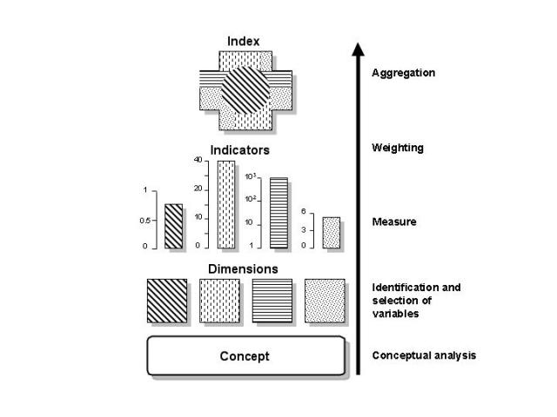
Defining Indicators
An indicator is something that represents a particular attribute, characteristic or property of a system
An indicator is a measurable part of a system
An index is made up of, or summarises, several indicators

Slide 24

Characteristics of Monitoring Systems
Accurate
  Low margins of error in measurement
Neutral
  Provide a balanced account of performance
Comparable
  Consistency over time so can make comparisons
Clear
  Easy to understand
Timely
  Conducted on a schedule that fits management activities

Slide 25
SUSTAINABLE ENTERPRISE
SESSION 6 of 7
THE
DEVELOPING
WORLD

Slide 26
5 Types of Countries
Giant Countries: India, China, Brazil
The cross-over countries: the Asian Tiger Countries
The oil states dependent on exporting one commodity
Majority of Third World Countries with little prospect of changing their economic status
Mini-states and many of them islands with few if any resources and must depend on aid or a single asset such as a natural attraction or tourism

Slide 27
SUSTAINABLE ENTERPRISE
SESSION 7 of 7
FROM
GOOD
TO
GREAT

Slide 28
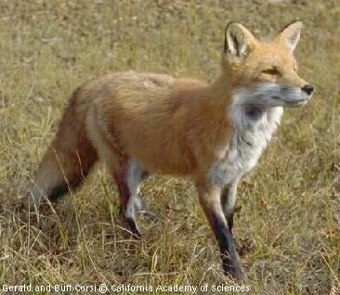
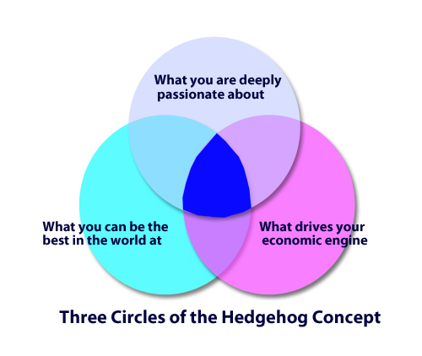
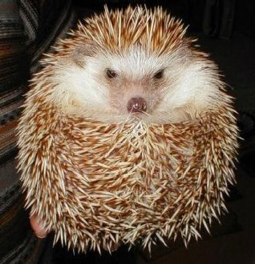
Three Point Concept
1
This part represents the contents of all 3 circles
A fox – has many ways to escape its enemies
A hedgehog – has but one way
The fox is often confused as to what to do.
The hedgehog is never confused
2
3
i.e. have one good plan and stick to it

Slide 29
“Good to great concepts that
lead to sustained ‘great’ results, plus
‘built to last’ concepts, that together
create sustainable businesses that prosper and flourish under any circumstance”

Slide 30
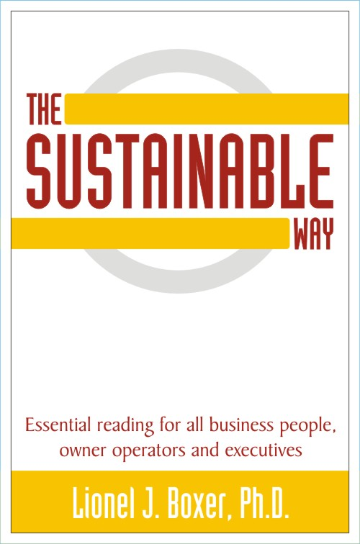

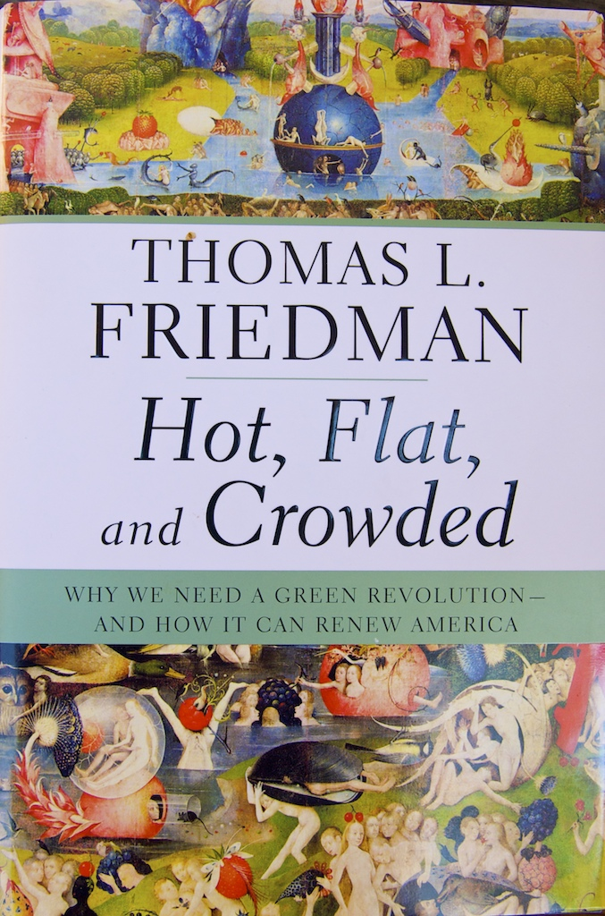
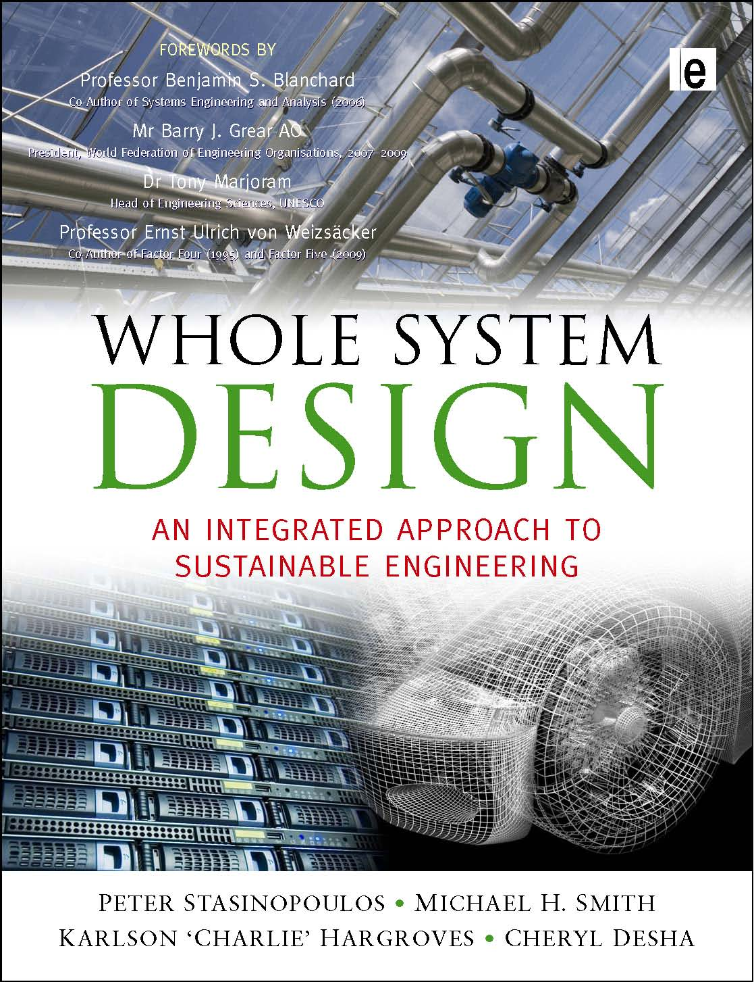
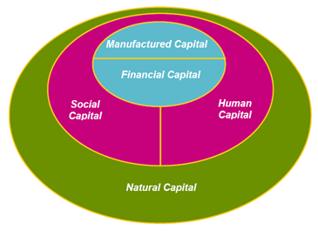
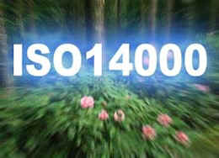

These are the 5 main forms of Capital in any business

